Slide 1
Greedy algorithms
Thanks to David Kauchak

Slide 2
Greedy algorithms
What is a greedy algorithm?
Algorithm that makes a local decision with the goal of creating a globally optimal solution
Method for solving problems where optimal solutions can be defined in terms of optimal solutions to sub-problems
What does this mean? Where have we seen this before?

Slide 3
Greedy vs. divide and conquer
Divide and conquer
To solve the general problem:
Break into sum number of sub problems, solve:
then possibly do a little work

Slide 4
Greedy vs. divide and conquer
Divide and conquer
To solve the general problem:
The solution to the general problem is solved with respect to solutions to sub-problems!

Slide 5
Greedy vs. divide and conquer
Greedy
To solve the general problem:
Pick a locally optimal solution and repeat

Slide 6
Greedy vs. divide and conquer
Greedy
To solve the general problem:
The solution to the general problem is solved with respect to solutions to sub-problems!
Slightly different than divide and conquer

Slide 7
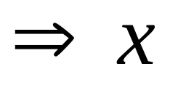
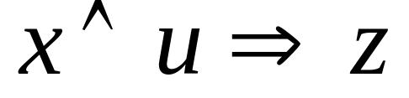
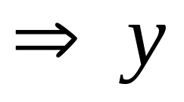
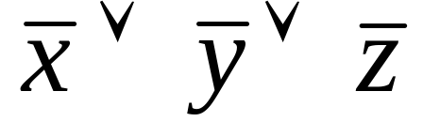
Horn formula
A horn formula is a set of implications and negative clauses:

Slide 8
Goal
Given a horn formula, determine if the formula is satisfiable, i.e. an assignment of true/false to the variables that is consistent with all of the implications/causes
u x y z
0 1 1 0

Slide 9
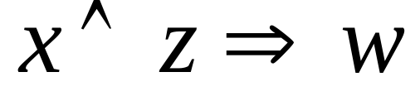
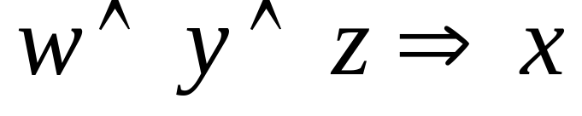
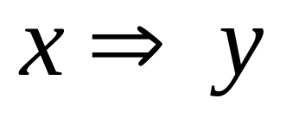
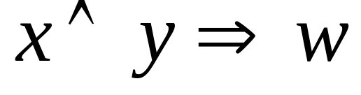
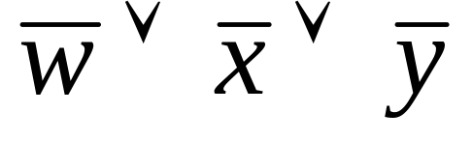
A greedy solution?
w 0
x 0
y 0
z 0

Slide 10
A greedy solution?
w 0
x 1
y 0
z 0

Slide 11
A greedy solution?
w 0
x 1
y 1
z 0

Slide 12
A greedy solution?
w 1
x 1
y 1
z 0

Slide 13
A greedy solution?
w 1
x 1
y 1
z 0
not satisfiable

Slide 14
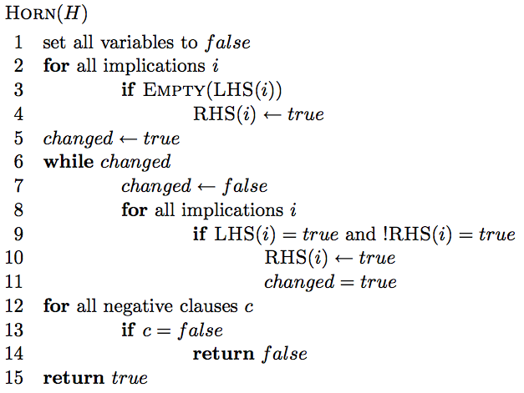
A greedy solution

Slide 15
A greedy solution
set all variables of the implications of the form “⇒x” to true

Slide 16
A greedy solution
if the all variables of the lhs of an implication are true, then set the rhs variable to true

Slide 17
A greedy solution
see if all of the negative clauses are satisfied

Slide 18
Correctness of greedy solution
Two parts:
  If our algorithm returns an assignment, is it a valid assignment?
  If our algorithm does not return an assignment, does an assignment exist?

Slide 19
Correctness of greedy solution
If our algorithm returns an assignment, is it a valid assignment?

Slide 20
Correctness of greedy solution
If our algorithm returns an assignment, is it a valid assignment?
explicitly check all negative clauses

Slide 21
Correctness of greedy solution
If our algorithm returns an assignment, is it a valid assignment?
don’t stop until all implications with all lhs elements true have rhs true

Slide 22
Correctness of greedy solution
If our algorithm does not return an assignment, does an assignment exist?
Our algorithm is “stingy”. It only sets those variables that have to be true. All others remain false.

Slide 23
Running time?
?
n = number of variables
m = number of formulas

Slide 24
Running time?
O(nm)
n = number of variables
m = number of formulas

Slide 25
Data compression
Given a file containing some data of a fixed alphabet Σ (e.g. A, B, C, D), we would like to pick a binary character code that minimizes the number of bits required to represent the data.
minimize the size of the encoded file
A C A D A A D B …
0010100100100 …

Slide 26
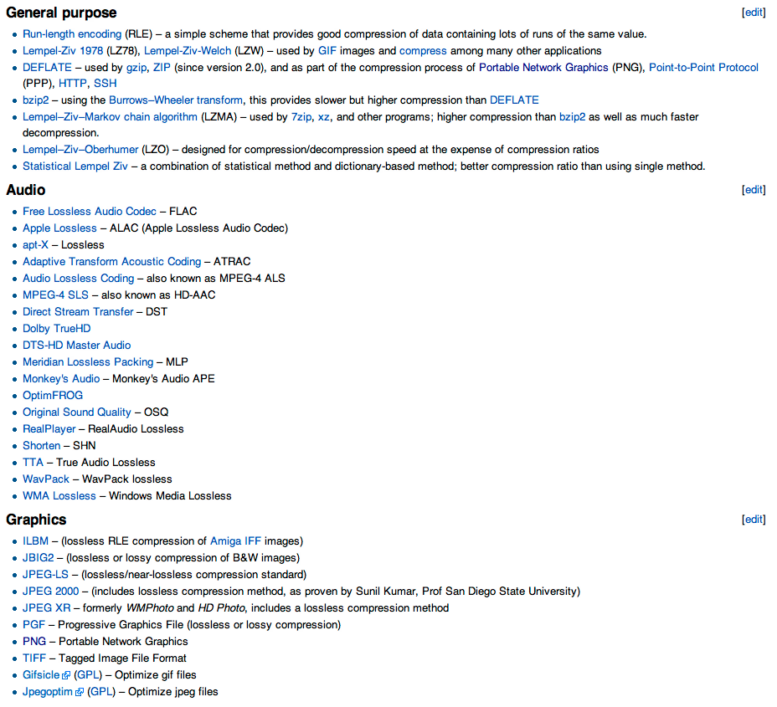
Compression algorithms
http://en.wikipedia.org/wiki/Lossless_data_compression

Slide 27
Simplifying assumption: frequency only
Assume that we only have character frequency information for a file
A C A D A A D B …
Symbol | Frequency
A B C D | 70 3 20 37
=

Slide 28
Fixed length code
Use ceil(log₂|Σ|) bits for each character
A =
B =
C =
D =

Slide 29
Fixed length code
Use ceil(log₂|Σ|) bits for each character
Symbol | Frequency
A B C D | 70 3 20 37
A = 00
B = 01
C = 10
D = 11
2 x 70 +
2 x 3 +
2 x 20 +
2 x 37 =
260 bits
How many bits to encode the file?

Slide 30
Fixed length code
Use ceil(log₂|Σ|) bits for each character
Symbol | Frequency
A B C D | 70 3 20 37
A = 00
B = 01
C = 10
D = 11
2 x 70 +
2 x 3 +
2 x 20 +
2 x 37 =
260 bits
Can we do better?

Slide 31
Variable length code
What about:
Symbol | Frequency
A B C D | 70 3 20 37
A = 0
B = 01
C = 10
D = 1
1 x 70 +
2 x 3 +
2 x 20 +
1 x 37 =
153 bits
How many bits to encode the file?

Slide 32
Decoding a file
A = 0
B = 01
C = 10
D = 1
010100011010
What characters does this sequence represent?

Slide 33
Decoding a file
A = 0
B = 01
C = 10
D = 1
010100011010
A D or B?
What characters does this sequence represent?

Slide 34
Variable length code
What about:
Symbol | Frequency
A B C D | 70 3 20 37
A = 0
B = 100
C = 101
D = 11
Is it decodeable?

Slide 35
Variable length code
What about:
Symbol | Frequency
A B C D | 70 3 20 37
A = 0
B = 100
C = 101
D = 11
1 x 70 +
3 x 3 +
3 x 20 +
2 x 37 =
213 bits
(18% reduction)
How many bits to encode the file?

Slide 36
Prefix codes
A prefix code is a set of codes where no codeword is a prefix of any other codeword
A = 0
B = 01
C = 10
D = 1
A = 0
B = 100
C = 101
D = 11

Slide 37
Prefix tree
We can encode a prefix code using a full binary tree where each leaf represents an encoding of a symbol
0
1
A = 0
B = 100
C = 101
D = 11
A
D
B
C

Slide 38
Decoding using a prefix tree
To decode, we traverse the graph until a leaf node is reached and output the symbol
0
1
A = 0
B = 100
C = 101
D = 11
A
D
B
C

Slide 39
Decoding using a prefix tree
Traverse the graph until a leaf node is reached and output the symbol
0
1
1000111010100
A
D
B
C

Slide 40
Decoding using a prefix tree
Traverse the graph until a leaf node is reached and output the symbol
0
1
1000111010100
B
A
D
B
C

Slide 41
Decoding using a prefix tree
Traverse the graph until a leaf node is reached and output the symbol
0
1
1000111010100
B A
A
D
B
C

Slide 42
Decoding using a prefix tree
Traverse the graph until a leaf node is reached and output the symbol
0
1
1000111010100
B A D
A
D
B
C

Slide 43
Decoding using a prefix tree
Traverse the graph until a leaf node is reached and output the symbol
0
1
1000111010100
B A D C
A
D
B
C

Slide 44
Decoding using a prefix tree
Traverse the graph until a leaf node is reached and output the symbol
0
1
1000111010100
B A D C A
A
D
B
C

Slide 45
Decoding using a prefix tree
Traverse the graph until a leaf node is reached and output the symbol
0
1
1000111010100
B A D C A B
A
D
B
C

Slide 46
Determining the cost of a file
Symbol | Frequency
A B C D | 70 3 20 37
0
1
A
D
B
C

Slide 47
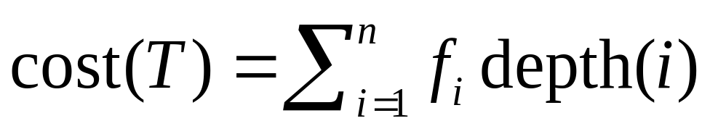
Determining the cost of a file
Symbol | Frequency
A B C D | 70 3 20 37
0
1
A
70
D
37
B
C
3
20

Slide 48
Determining the cost of a file
Symbol | Frequency
A B C D | 70 3 20 37
0
1
A
70
60
D
What if we label the internal nodes with the sum of the children?
23
37
B
C
3
20

Slide 49
Determining the cost of a file
Symbol | Frequency
A B C D | 70 3 20 37
0
1
A
70
60
D
Cost is equal to the sum of the internal nodes and the leaf nodes
23
37
B
C
3
20

Slide 50
Determining the cost of a file
As we move down the tree, one bit gets read for every nonroot node
0
1
70 times we see a 0 by itself
60 times we see a prefix that starts with a 1
A
70
60
of those, 37 times we see an additional 1
D
23
37
the remaining 23 times we see an additional 0
B
C
of these, 20 times we see a last 1 and 3 times a last 0
3
20

Slide 51
A greedy algorithm?
Given file frequencies, can we come up with a prefix-free encoding (i.e. build a prefix tree) that minimizes the number of bits?
0
1
A
Symbol | Frequency
A B C D | 70 3 20 37
D
B
C

Slide 52
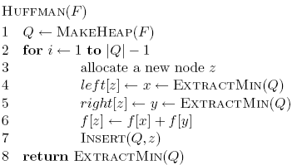
A greedy algorithm?
Given file frequencies, can we come up with a prefix-free encoding (i.e. build a prefix tree) that minimizes the number of bits?

Slide 53
Symbol | Frequency
A B C D | 70 3 20 37
Heap

Slide 54
Symbol | Frequency
A B C D | 70 3 20 37
Heap
B 3
C 20
D 37
A 70

Slide 55
Symbol | Frequency
A B C D | 70 3 20 37
Heap
merging with this node will incur an additional cost of 23
BC 23
D 37
A 70
23
B
C
3
20

Slide 56
Symbol | Frequency
A B C D | 70 3 20 37
Heap
BCD 60
A 70
60
D
23
37
B
C
3
20

Slide 57
Symbol | Frequency
A B C D | 70 3 20 37
Heap
A
ABCD 130
70
60
D
23
37
B
C
3
20

Slide 58
Is it correct?
The algorithm selects the symbols with the two smallest frequencies first (call them f₁ and f₂)

Slide 59
Is it correct?
The algorithm selects the symbols with the two smallest frequencies first (call them f₁ and f₂)
Consider a tree that did not do this (proof by contradiction):
Is it optimal?
f₁
f_{i}
f₂

Slide 60
Is it correct?
The algorithm selects the symbols with the two smallest frequencies first (call them f₁ and f₂)
Consider a tree that did not do this:
- frequencies don’t change
- cost will decrease since
f₁ < f_{i}
f₁
f_{i}
f_{i}
f₂
f₁
f₂
contradiction

Slide 61
Runtime?
1 call to MakeHeap
2(n-1) calls ExtractMin
n-1 calls Insert
O(n log n)

Slide 62
Non-optimal greedy algorithms
All the greedy algorithms we’ve looked at so far give the optimal answer
Some of the most common greedy algorithms generate good, but non-optimal solutions
  set cover
  clustering
  hill-climbing
  relaxation

Slide 63
Knapsack problems:
Greedy or not?
0-1 Knapsack – A thief robbing a store finds n items worth v₁, v₂, .., v_{n} dollars and weight w₁, w₂, …, w_{n} pounds, where v_{i} and w_{i} are integers. The thief can carry at most W pounds in the knapsack. Which items should the thief take if he wants to maximize value.
Fractional knapsack problem – Same as above, but the thief happens to be at the bulk section of the store and can carry fractional portions of the items. For example, the thief could take 20% of item i for a weight of 0.2w_{i} and a value of 0.2v_{i}.

